Slide 1
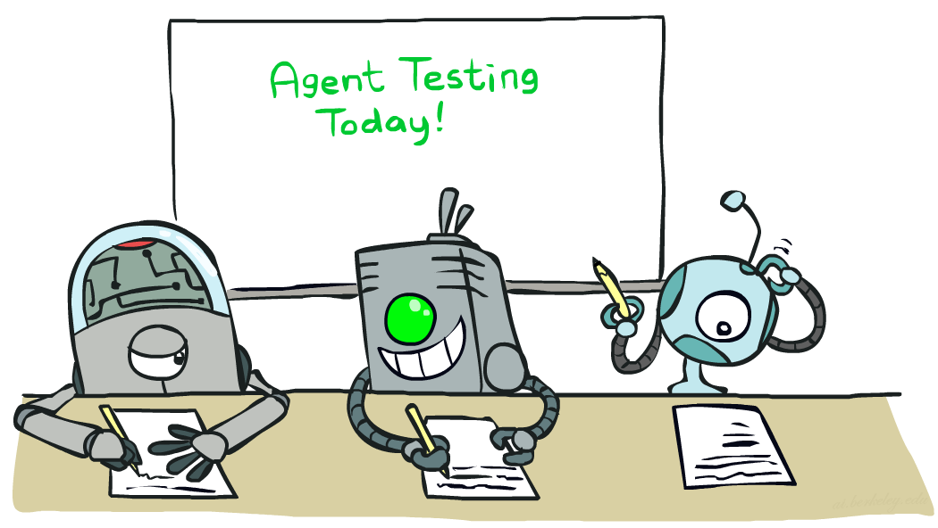

CS 188: Artificial Intelligence
Learning I:
Instructors: Stuart Russell and Dawn Song
University of California, Berkeley
Notes:
Please retain proper attribution, including the reference to ai.berkeley.edu. Thanks!

Slide 2
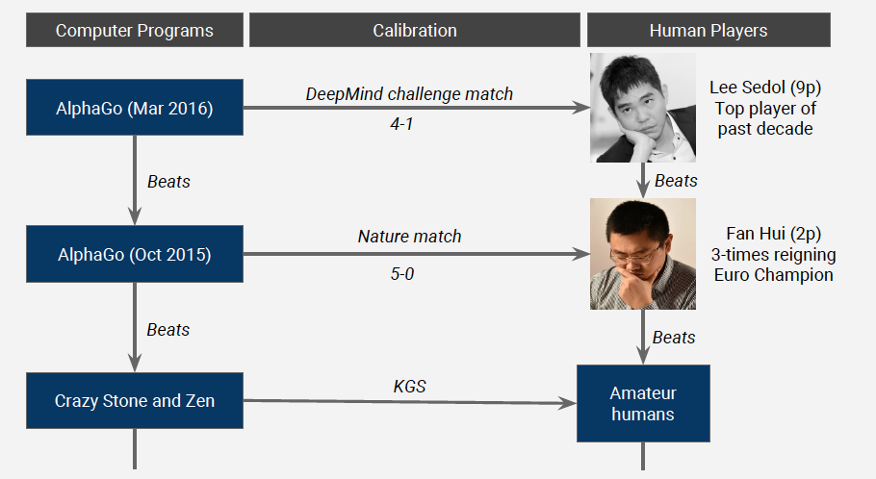
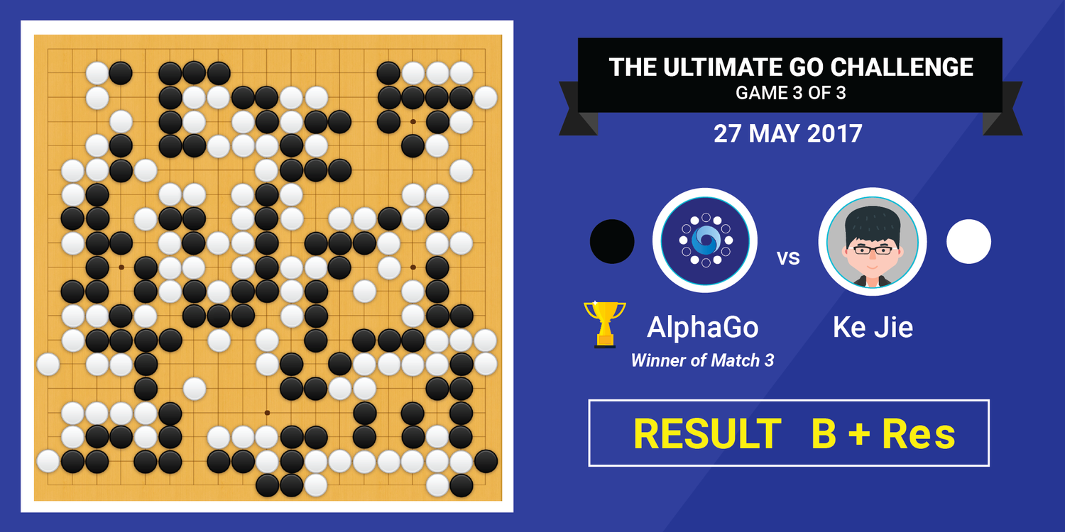
AlphaGo & AlphaStar: Winning over World Champions
Source: David Silver
Notes:
Deep learning has been making huge advances across numerous domains. AlphaGo has won over world champions recently, in both Korea and China.

Slide 3
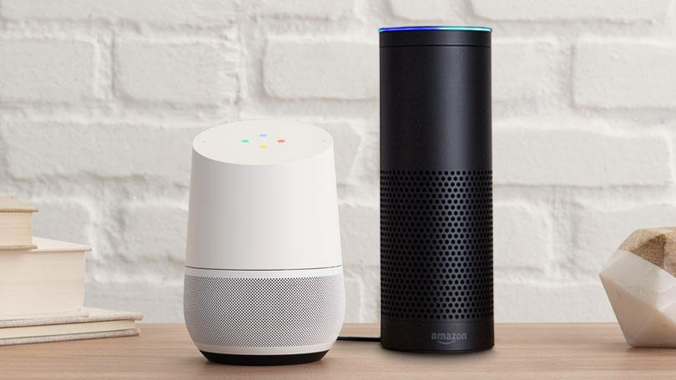
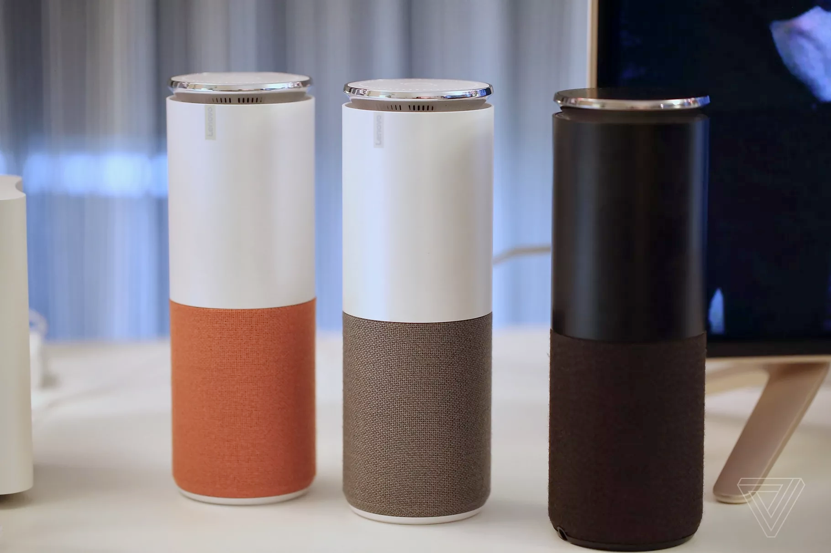


Deep Learning Powering Everyday Products
pcmag.com
theverge.com
Notes:
Deep learning is helping us in every day life as smart virtual assistants

Slide 4
Lectures on learning
Learning: a process for improving the performance of an agent through experience
Learning I (today):
The general idea: generalization from experience
Supervised learning: classification and regression
Learning II: neural networks and deep learning
Learning III: statistical learning and Bayes nets
Reinforcement learning II: learning complex V and Q functions

Slide 5
Learning: Why?
The baby, assailed by eyes, ears, nose, skin, and entrails at once, feels it all as one great blooming, buzzing confusion …
[William James, 1890]
Learning is essential in unknown environments – when the agent designer lacks omniscience

Slide 6
Learning: Why?
Instead of trying to produce a programme to simulate the adult mind, why not rather try to produce one which simulates the child's? If this were then subjected to an appropriate course of education one would obtain the adult brain. Presumably the child brain is something like a notebook as one buys it from the stationer's. Rather little mechanism, and lots of blank sheets.
[Alan Turing, 1950]
Learning is useful as a system construction method, i.e., expose the system to reality rather than trying to write it down

Slide 7
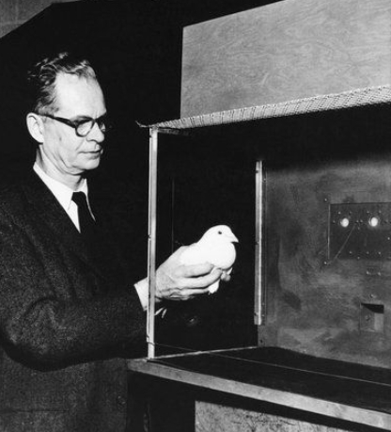
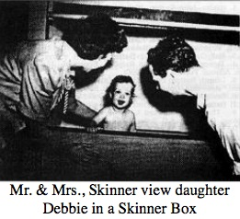
Learning: How?

Slide 8
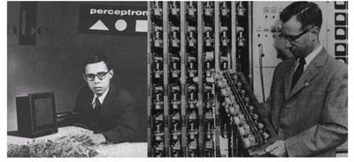
Learning: How?
Notes:
Frank Rosenblatt (left);

Slide 9
Key questions when building a learning agent
What is the agent design that will implement the desired performance?
Improve the performance of what piece of the agent system and how is that piece represented?
What data are available relevant to that piece? (In particular, do we know the right answers?)
What knowledge is already available?

Slide 10
Examples
Agent design | Component | Representation | Feedback | Knowledge
Alpha-beta search | Evaluation function | Linear polynomial | Win/loss | Rules of game; Coefficient signs
Logical planning agent | Transition model (observable envt) | Successor-state axioms | Action outcomes | Available actions; Argument types
Utility-based patient monitor | Physiology/sensor model | Dynamic Bayesian network | Observation sequences | Gen physiology; Sensor design
Satellite image pixel classifier | Classifier (policy) | Markov random field | Partial labels | Coastline; Continuity scales
Supervised learning: correct answers for each training instance
Reinforcement learning: reward sequence, no correct answers
Unsupervised learning: “just make sense of the data”

Slide 11
Supervised learning
To learn an unknown target function f
Input: a training set of labeled examples (x_{j},y_{j}) where y_{j} = f(x_{j})
E.g., x_{j} is an image, f(x_{j}) is the label “giraffe”
E.g., x_{j} is a seismic signal, f(x_{j}) is the label “explosion”
Output: hypothesis h that is “close” to f, i.e., predicts well on unseen examples (“test set”)
Many possible hypothesis families for h
Linear models, logistic regression, neural networks, decision trees, examples (nearest-neighbor), grammars, kernelized separators, etc etc
Classification = learning f with discrete output value
Regression = learning f with real-valued output value

Slide 12



Inductive Learning (Science)
Simplest form: learn a function from examples
A target function: g
Examples: input-output pairs (x, g(x))
E.g. x is an email and g(x) is spam / ham
E.g. x is a house and g(x) is its selling price
Problem:
Given a hypothesis space H
Given a training set of examples x_{i}
Find a hypothesis h(x) such that h ~ g
Includes:
Classification (outputs = class labels)
Regression (outputs = real numbers)

Slide 13
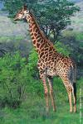
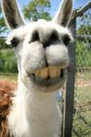
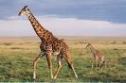
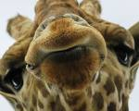
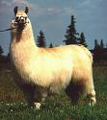
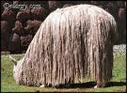
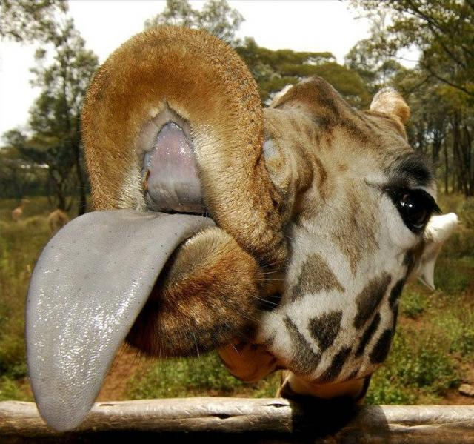
Classification example: Object recognition
x
f(x)
giraffe
giraffe
giraffe
llama
llama
llama
X=
f(x)=?

Slide 14
Regression example: Curve fitting

Slide 15
Regression example: Curve fitting

Slide 16
Regression example: Curve fitting

Slide 17
Regression example: Curve fitting

Slide 18
Regression example: Curve fitting

Slide 19
Consistency vs. Simplicity
Fundamental tradeoff: bias vs. variance
Usually algorithms prefer consistency by default (why?)
Several ways to operationalize “simplicity”
Reduce the hypothesis space
Assume more: e.g. independence assumptions, as in naïve Bayes
Have fewer, better features / attributes: feature selection
Other structural limitations (decision lists vs trees)
Regularization
Smoothing: cautious use of small counts
Many other generalization parameters (pruning cutoffs today)
Hypothesis space stays big, but harder to get to the outskirts

Slide 20
Basic questions
Which hypothesis space H to choose?
How to measure degree of fit?
How to trade off degree of fit vs. complexity?
“Ockham’s razor”
How do we find a good h?
How do we know if a good h will predict well?

Slide 21
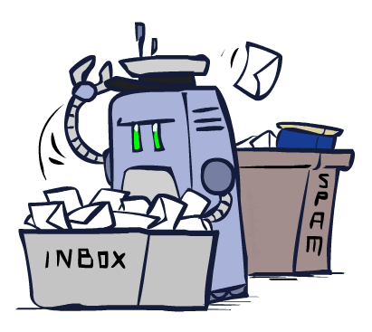
Classification

Slide 22
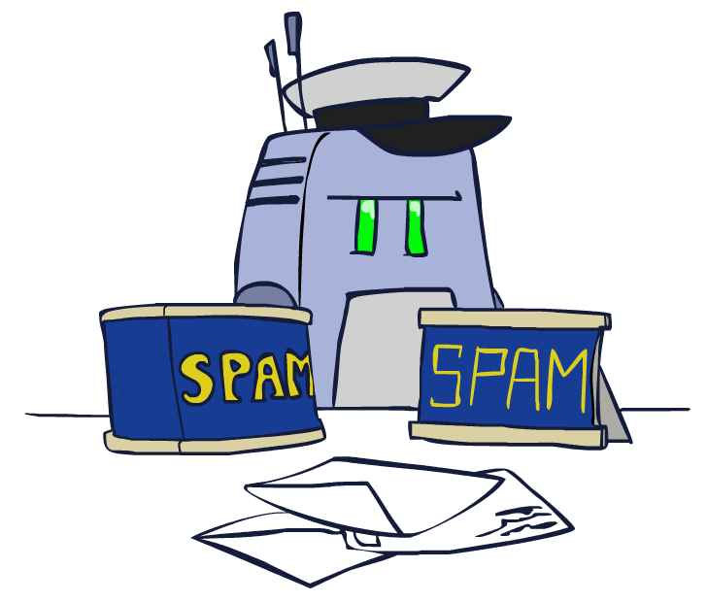
Example: Spam Filter
Input: an email
Output: spam/ham
Setup:
Get a large collection of example emails, each labeled “spam” or “ham” (by hand)
Learn to predict labels of new incoming emails
Classifiers reject 200 billion spam emails per day
Features: The attributes used to make the ham / spam decision
Words: FREE!
Text Patterns: $dd, CAPS
Non-text: SenderInContacts, AnchorLinkMismatch
…
Dear Sir.
First, I must solicit your confidence in this transaction, this is by virture of its nature as being utterly confidencial and top secret. …
TO BE REMOVED FROM FUTURE MAILINGS, SIMPLY REPLY TO THIS MESSAGE AND PUT "REMOVE" IN THE SUBJECT.
99 MILLION EMAIL ADDRESSES
FOR ONLY $99
Ok, Iknow this is blatantly OT but I'm beginning to go insane. Had an old Dell Dimension XPS sitting in the corner and decided to put it to use, I know it was working pre being stuck in the corner, but when I plugged it in, hit the power nothing happened.
Notes:
ask students to classify three emails one at a time before revealing classifications!

Slide 23




Example: Digit Recognition
Input: images / pixel grids
Output: a digit 0-9
Setup:
MNIST data set of 60K collection hand-labeled images
Note: someone has to hand label all this data!
Want to learn to predict labels of new digit images
Features: The attributes used to make the digit decision
Pixels: (6,8)=ON
Shape Patterns: NumComponents, AspectRatio, NumLoops
…
0
1
2
1
??
Notes:
ask students to classify five digits one at a time before revealing classifications!

Slide 24
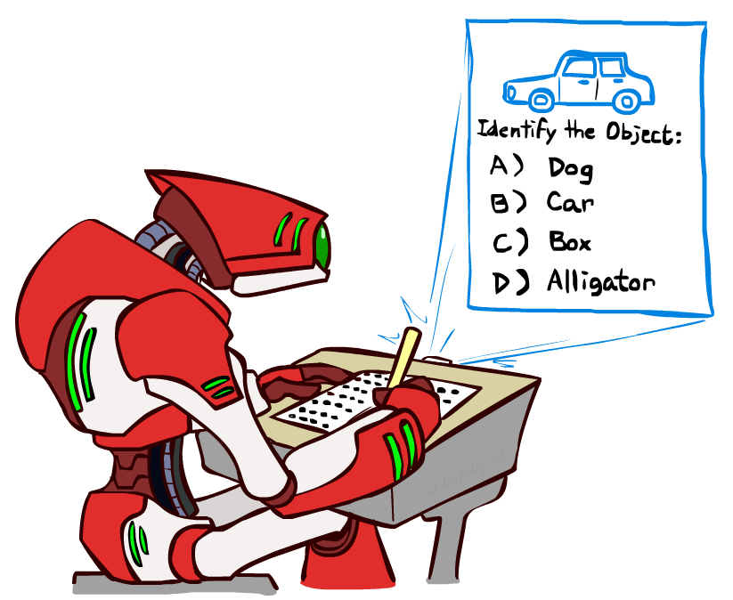
Other Classification Tasks
Medical diagnosis
input: symptoms
output: disease
Automatic essay grading
input: document
output: grades
Fraud detection
input: account activity
output: fraud / no fraud
Email routing
input: customer complaint email
output: which department needs to ignore this email
Fruit and vegetable inspection
input: image (or gas analysis)
output: moldy or OK
… many more

Slide 25
Decision tree learning
Decision tree models
Tree construction
Measuring learning performance

Slide 26
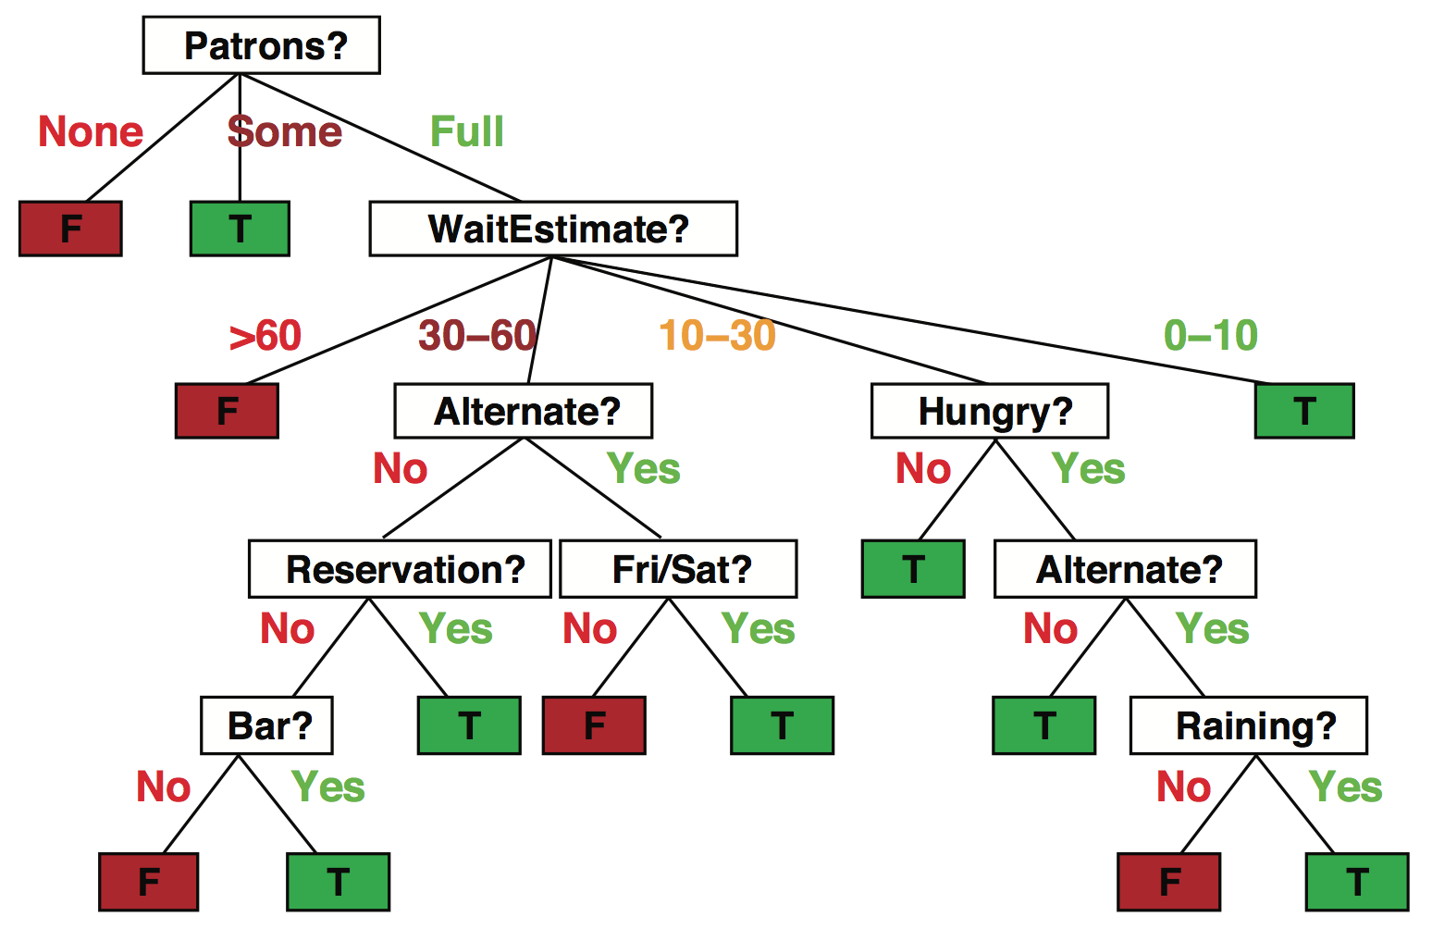
Decision trees
Popular representation for classifiers
Even among humans!
I’ve just arrived at a restaurant: should I stay (and wait for a table) or go elsewhere?

Slide 27
Decision trees
It’s Friday night and you’re hungry
You arrive at your favorite cheap but really cool happening burger place
It’s full up and you have no reservation but there is a bar
The host estimates a 45 minute wait
There are alternatives nearby but it’s raining outside
Decision tree partitions the input space, assigns a label to each partition

Slide 28
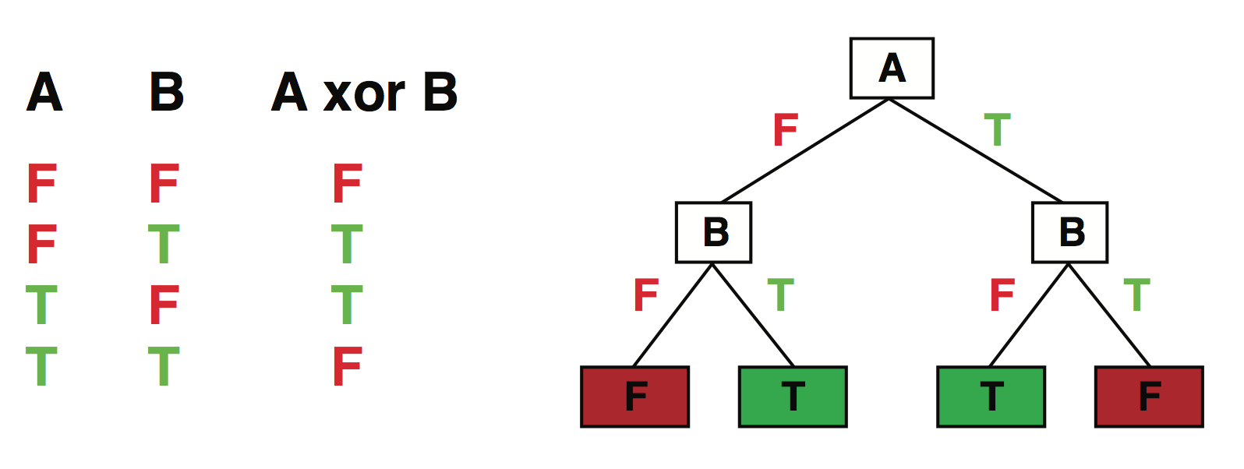
Expressiveness
Discrete decision trees can express any function of the input in propositional logic
E.g., for Boolean functions, build a path from root to leaf for each row of the truth table:
True/false: there is a consistent decision tree that fits any training set exactly
But a tree that simply records the examples is essentially a lookup table
To get generalization to new examples, need a compact tree

Slide 29
Quiz
How many distinct functions of n Boolean attributes?
= number of truth tables with n inputs
= number of ways of filling in output column with 2^{n} entries
= 2^{2n}
For n=6 attributes, there are 18,446,744,073,709,551,616 functions
and many more trees than that!

Slide 30
Hypothesis spaces in general
Increasing the expressiveness of the hypothesis language
Increases the chance that the true function can be expressed
Increases the number of hypotheses that are consistent with training set
=> many consistent hypotheses have large test error
=> may reduce prediction accuracy!
With 2^{2n} hypotheses, all but an exponentially small fraction will require O(2^{n}) bits to express in any representation (even brains!)
I.e., any given representation can represent only an exponentially small fraction of hypotheses concisely; no universal compression
E.g., decision trees are bad at “k-out-of-n” functions

